Slide 1

Final Project for ECE 514
Time Series Forecasting for Energy Consumption in Greece
PANAGIOTIS TOLOUDIS

Slide 2




Agenda
The dataset
Arima
LSTM
Prophet
Xgboost
AutoML

Slide 3



Introduction
Time series forecasting plays a crucial role in machine learning as it addresses prediction problems involving a temporal component. However, time series forecasting in energy consumption presents unique challenges due to the unpredictable nature of energy demand and the multitude of factors influencing it. One such challenge is the seasonality of energy consumption, where usage patterns vary based on the time of day, day of the week, and time of year. Additionally, external factors like weather patterns, economic conditions, and technological advancements can further complicate energy consumption predictions. The rise of renewable energy sources adds complexity as their output depends on unpredictable weather conditions. Moreover, policy changes and regulations can significantly impact energy demand, making their prediction difficult. Considering these complexities, forecasting energy consumption accurately becomes crucial for effective energy management and decision-making.

Slide 4

The dataset

Slide 5
Information about the Dataset
The dataset used for the project is sourced from Open Power System Data, a free-of-charge data platform dedicated to electricity system researchers. This platform collects, verifies, processes, documents, and publishes publicly available but otherwise inconvenient-to-use data. It provides various data sets, including information on installed generation capacity by country/technology, individual power plants (both conventional and renewable), and time series data. The time series data includes electricity consumption, spot prices, and wind and solar generation, derived from weather models and measured sources. The platform ensures machine readability and easy integration by following the Data Package convention and publishing data primarily as CSV files with metadata in JSON format (Excel and SQLite files are also available). To ensure reproducibility, both the data and scripts used for processing are version-controlled and accessible through stable URLs. For this project, the dataset version 2020-10-06 was selected, which contains data for 32 European countries at different time intervals (15 min, 30 min, and 60 min). The 60 min interval dataset was chosen specifically to work with the data for Greece.

Slide 6
Prepare the dataset
Remove all the information to not use.
keep the data from the 1/1/2018-0:00 to 10/1/2020-1:00
Notes:
dataset is too big from my machine

Slide 7

ARIMA

Slide 8
What is the Arima model?
The ARIMA model is a statistical tool that can be used to analyze and forecast time series data. ARIMA stands for Auto-Regressive Integrated Moving Average, which means that the model combines three components:
- Auto-regression (AR): The model uses past values of the variable to predict its future values.
- Integration (I): The model applies differencing to the data to make it stationary, meaning that it has a constant mean and variance over time.
- Moving average (MA): The model incorporates the errors or noise from past predictions into the current prediction.
The ARIMA model is represented by three parameters: p, d, and q, which correspond to the order of the AR, I, and MA components respectively. For example, an ARIMA (1,1,1) model means that it has one AR term, one differencing term, and one MA term. The ARIMA model can be used to fit various types of time series data that have different patterns or trends.

Slide 9
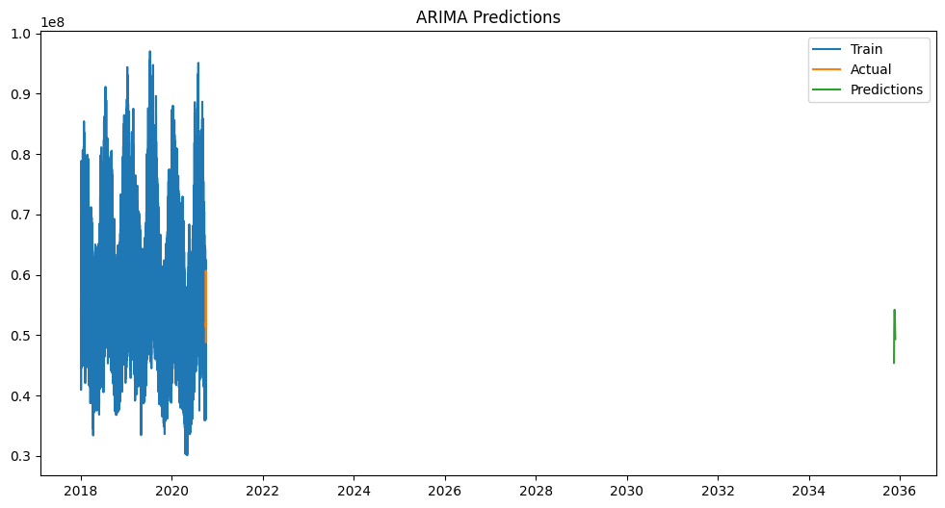
The GR load actual entsoe transparency.
Predict
4.542353e+07
4.827820e+07
5.090549e+07
5.268140e+07
5.368239e+07
5.421035e+07
5.386518e+07
5.324477e+07
5.238635e+07
5.118879e+07
5.029158e+07
4.936184e+07
Actual
48829300
51866700
56699300
59324400
59963000
60683000
59905200
57309600
54244800
51964000
51317100
51973500

Slide 10
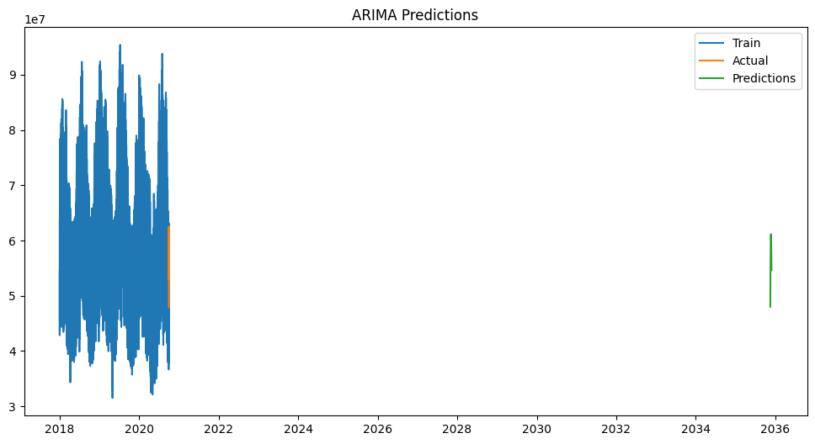
The GR load forecast entsoe transparency.
Predict
4.801549e+07
5.185250e+07
5.517169e+07
5.765611e+07
5.952495e+07
6.069373e+07
6.113299e+07
6.086623e+07
5.996439e+07
5.853738e+07
5.672351e+07
5.467779e+07
Actual
47929100
53457600
57901100
60439800
61694900
62520600
61888600
60031100
56648700
54124400
53025000
53551000

Slide 11
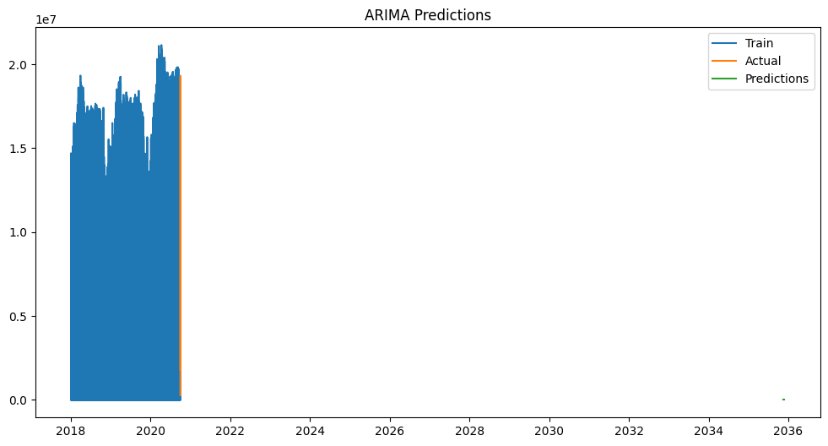
The GR solar generation actual.
Predict
-7.738259e-28
-7.107229e-27
-1.281375e-26
-1.658644e-26
-1.851140e-26
-1.937587e-26
-1.908771e-26
-1.774846e-26
-1.581328e-26
-1.385117e-26
-1.222900e-26
-1.112447e-26
Actual
270000.0
3980000.0
9750000.0
14410000.0
17690000.0
19310000.0
19080000.0
17830000.0
15530000.0
11690000.0
900000.0
1780000.0

Slide 12
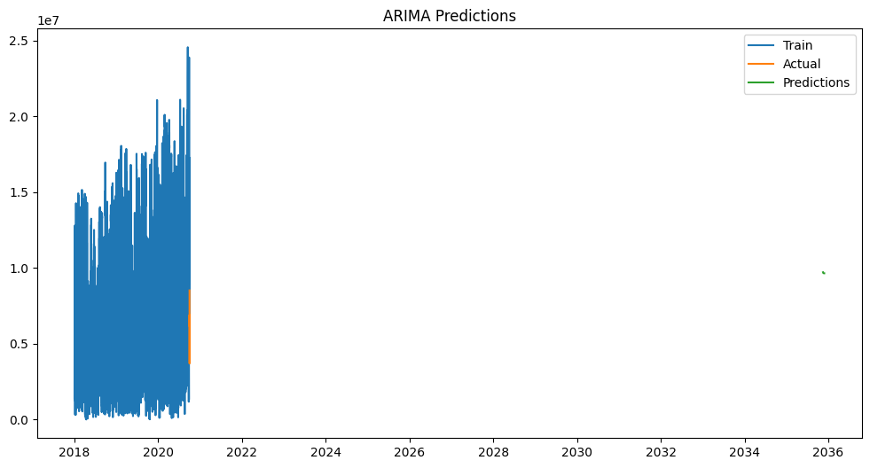
The GR wind onshore generation actual.
Predict
9.715729e+06
9.690254e+06
9.674105e+06
9.663869e+06
9.657380e+06
9.653267e+06
9.650659e+06
9.649006e+06
9.647959e+06
9.647294e+06
9.646873e+06
9.646606e+06
Actual
8520000.0
5870000.0
4390000.0
3700000.0
3780000.0
4120000.0
4980000.0
5880000.0
6290000.0
6470000.0
6910000.0
6180000.0

Slide 13

LSTM

Slide 14

What is the LSTM model?
The LSTM model is a type of recurrent neural network (RNN) that can process sequential data, such as speech, text, or video. Unlike standard RNNs, LSTM has a special structure that allows it to remember information over long periods of time. An LSTM cell consists of four components: a cell state, an input gate, an output gate, and a forget gate. The cell state stores the long-term memory of the network, while the gates control how much information to keep or discard from the cell state and the inputs. LSTM can learn complex patterns and dependencies in sequential data and is widely used for tasks such as natural language processing, speech recognition, machine translation, and more.

Slide 15

The model results.
The evaluate of the model is 0.03626 in the test data.

Slide 16

PROPHET

Slide 17

What is the Prophet model?
The Prophet model is a procedure for forecasting time series data based on an additive model where non-linear trends are fit with yearly, weekly, and daily seasonality, plus holiday effects. It works best with time series that have strong seasonal effects and several seasons of historical data. The Prophet model consists of four main components: a piecewise linear or logistic growth curve trend, a yearly seasonal component modeled using Fourier series, a weekly seasonal component modeled using dummy variables, and holiday effects modeled as dummy variables. The model is estimated using a Bayesian approach and is robust to missing data, shifts in the trend, and outliers. The Prophet model is designed to be simple for non-experts to use, yet flexible and powerful.

Slide 18
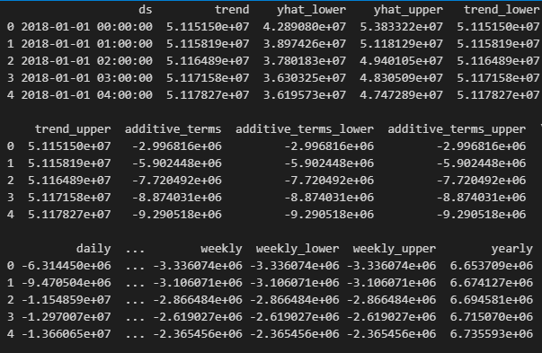
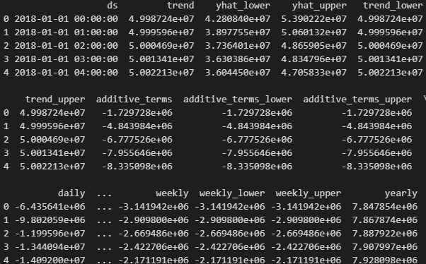
The GR load actual entsoe transparency.
The GR load forecast entsoe transparency.

Slide 19
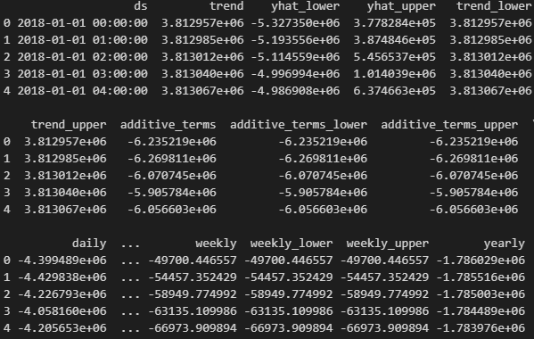
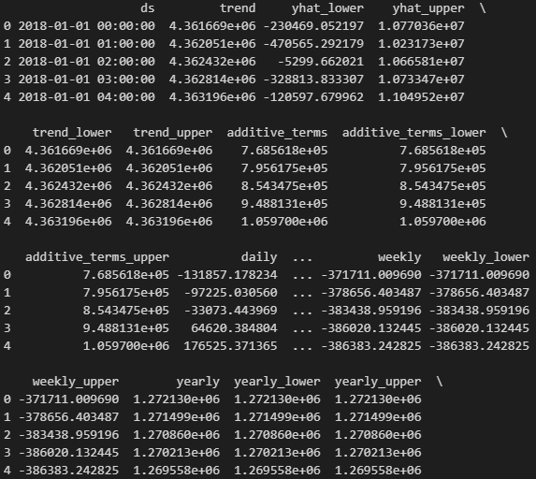
The GR Solar generation actual.
The GR wind onshore generation actual.

Slide 20

XGBOOST

Slide 21

What is the Xgboost model?
XGBoost is a machine learning framework that uses gradient boosting to create accurate and efficient predictive models. Gradient boosting is a technique that combines multiple weak learners (such as decision trees) into a strong learner by iteratively adding new learners that correct the errors of the previous ones. XGBoost stands for extreme Gradient Boosting, and it is designed to be scalable, fast, and robust to various types of data and problems.

Slide 22
The GR load actual entsoe transparency.
The GR load forecast entsoe transparency.
Prediction | Actual
66201820 | 66171500
59507024 | 59467600
41082864 | 41086100
48974040 | 48956900
66303360 | 66414500
63670044 | 63641800
Prediction | Actual
51595084 | 51611600
40720100 | 40674700
76391744 | 76450000
60933364 | 60950300
55472148 | 55570000
63189272 | 63150000
The Mean Squared Error: 4179604559.307996
The Mean Squared Error: 3971697205.2060227

Slide 23
The GR solar generation actual.
The GR wind onshone generation actual.
Prediction | Actual
1.6871027e+02 | 0.0
1.6562167e+07 | 16590000.0
1.5606325e+07 | 15590000.0
1.6871027e+02 | 0.0
1.5405820e+07 | 15390000.0
1.6871027e+02 | 0.0
Prediction | Actual
17332950 | 17390000.0
1454575.5 | 1460000.0
11891878 | 11890000.0
4290031.5 | 4290000.0
13257710 | 13260000.0
19425660 | 19420000.0
The Mean Squared Error: 178525867.4920639
The Mean Squared Error: 227438983.1501955

Slide 24

AutoML

Slide 25

What is the AutoML model?
The AutoML model is a type of machine learning model that can automatically select the best architecture, hyperparameters, and data preprocessing steps for a given task. The AutoML model can save time and resources for developers and researchers who want to build and deploy machine learning solutions without requiring extensive expertise or manual tuning. The AutoML model can also discover novel and efficient architectures that outperform human-designed ones in some cases. The AutoML model is not a single algorithm, but a general framework that can be applied to different domains such as computer vision, natural language processing, and tabular data analysis.

Slide 26
The suggestions model.
H2o.ai
DataRobot
Google Cloud AutoML
The h2o.ai model is a machine learning platform that enables users to build and deploy scalable and accurate predictive models. The platform offers a variety of tools and features, such as automated data preparation, feature engineering, model selection, explain ability, and deployment. The h2o.ai model can handle structured and unstructured data, as well as supervised and unsupervised learning tasks. The h2o.ai model is designed to be user-friendly, fast, and flexible, making it suitable for various domains and applications.
The model DataRobot is a software that automates the process of building and deploying machine learning models. It uses a variety of algorithms, mostly based on open source, to train and evaluate thousands of models on a given dataset. It also provides tools for data quality assessment, feature engineering, model interpretation, and MLOps. The model DataRobot can help users of different skill levels to leverage the power of artificial intelligence and make better decisions based on data.
Google Cloud AutoML is a service that allows users to create custom machine learning models without coding. Users can upload their own data, choose a model type, and train the model using Google's infrastructure. The service also provides tools for evaluating, deploying, and managing the models. Google Cloud AutoML supports various types of data, such as images, text, tabular, and video.

Slide 27

The different between the models.
The H2O.ai and DataRobot offer more specialized features and capabilities for time series analysis compared to Google Cloud AutoML. H2O.ai provides the H2O AutoML framework with specific support for time series modeling, while DataRobot offers automated time series modeling as part of its comprehensive platform. On the other hand, Google Cloud AutoML provides a general-purpose machine learning platform that can be used for time series analysis by utilizing its broader set of tools and infrastructure.
I use the H20.ai model.

Slide 28
The result
Reported on train data.
Reported on cross-validation data.
Reported on test data.
MSE: 3517418035650.899 RMSE: 1875478.0818902948 MAE: 1386162.5148232258 RMSLE: 0.031496644655704585 Mean Residual Deviance: 3517418035650.899 R^2: 0.973268898953974 Null degrees of freedom: 10039 Residual degrees of freedom: 10032 Null deviance: 1.3212865205156608e+18 Residual deviance: 3.5314877077935024e+16 AIC: 318553.3189175752
MSE: 4453587215909.751 RMSE: 2110352.391405225 MAE: 1547279.8532015597 RMSLE: 0.03528657985361276 Mean Residual Deviance: 4453587215909.751 R^2: 0.9659232204704427 Null degrees of freedom: 19375 Residual degrees of freedom: 19368 Null deviance: 2.5325041424212966e+18 Residual deviance: 8.629270589546734e+16 AIC: 619325.493958776
MSE: 4528498171569.509
RMSE: 2128026.8258575853
MAE: 1557603.0190972523
RMSLE: 0.03565571506703599
Mean Residual Deviance: 4528498171569.509
R^2: 0.9645925630870953
Null degrees of freedom: 4720
Residual degrees of freedom: 4713
Null deviance: 6.038496502126353e+17
Residual deviance: 2.1379039867979652e+16
AIC: 150992.22118511234

Slide 29


Summary
Its excessive size (e+7) is the cause of the errors.
This project would benefit from having location, weather, and user power habits in addition to the power dataset.
XGBoost and LSTM are the models that fit this dataset the best.

Slide 30

Thank you
Panagiotis Toloudis
ptoloudis@uth.gr

